Slide 1
Compensation and Benefits
Compensation and benefits are the key factors in attracting and keeping the best human capital and ensuring that organization has the competitive edge in the increasing competitive world.
It is an Integral part of human resource management which helps in motivating the employees and improving organizational effectiveness.
It is a total of all rewards and recognition provided to employees by the employers in returns to their mental and physical sacrifice to the betterment of the company.
It is a systematic approach to providing monitory and non- monitory values / benefits to employees in exchange for work performed.

Slide 2
Definitions
According to Milkovich & Newman:
Compensation refers to all forms of financial returns and tangible services and benefits employees receive as part of an employment relationship.
Edwin B. Flippo:
Compensation is the adequate and equitable remuneration of personnel for their contributions to organizational objectives.

Slide 3
Total Compensation
Financial Benefits
Non-Financial Benefits
Direct Pay
Salary
Wages
Bonus
Incentives
Indirect Pay (Benefits)
Insurance
Paid leave
Retirement benefits
Recognition
Career Development
Work-life Balance

Slide 4
Forms of Pay
Base Pay
Variable Pay
Incentive Pay
Skill-based Pay
Gainsharing
Profit Sharing

Slide 5
Factors Affecting Compensation System
Internal Factors
Ability to Pay
Job Value
Employee Performance
Company Policy
External Factors
Labour Market
Cost of Living
Government Regulations
Industry Standards

Slide 6
Establishing Pay Rates
Job Analysis
Job Evaluation
Wage Survey
Pay Structure
Pay Adjustment

Slide 7
Employee Benefits
Employee Benefits, also known as perks or fringe benefits, are provided to employees over and above salaries and wages.
Statutory Benefits
Voluntary Benefits
Retirement Benefits
Work-life Benefits

Slide 8
Performance Management &Appraisal
Performance Management is a continuous and systematic approach that ensures the achievement of organizational business goals by streamlining employee performance and efforts to match the set goals efficiently.
Performance Appraisal is a process for evaluating and documenting how well an employee is carrying out his or her job. Performance appraisals are based on the employee's progress against goals set once a year with his or her manager.

Slide 9
Objectives of Performance Management
Develop clear role definitions, expectations and goals.
Increase employee engagement.
Develop managerial leadership and coaching skills.
Boost productivity through improved performance.
Develop a performance reward program that incentivizes accomplishment.

Slide 10
Performance Management v/s Performance Appraisal
S. No. | Performance Management | Performance Appraisal
1 | Continuous process-takes place multiple times in a year | Annual review of employees' overall performance
2 | Requires strategic planning and execution | Follows an operational process that does not require extensive planning
3 | Flexible in nature | Rigid in nature
4 | Employee engagement is the essence of Performance Management System (PMS) | Less employee engagement
5 | More transparency | Less transparency

Slide 11
Common Problems with Performance Appraisals
Manager’s judgment or assessment based on preferences.
Unstructured methods of performance appraisal systems.
Lack of interest and ownership of manager.
Lack of a proper channel of communication.
Lack of reward and recognition policy.
Lack of leadership.
Lack of designing, monitoring and measuring the performance appraisal standards.
Lack of communication.
Overemphasizing recent performances.
No recognition / rewards.

Slide 12
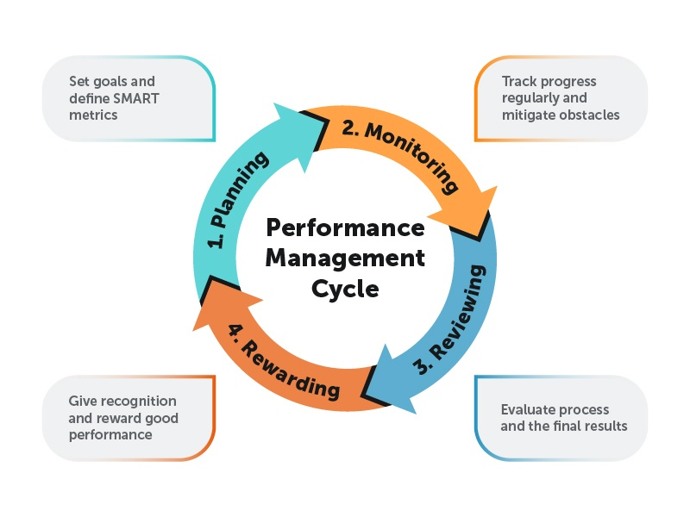
Performance Management Process
Performance Management requires that the manager should define the performance, facilitate performance and encourage performance.

Slide 13
Types of Performance Rating Systems
Performance Appraisal can be broadly classified into two categories.
Traditional Methods
Modern Methods

Slide 14
Traditional Methods
1. Ranking Method
According to Dessler et al. (2011), ranking method is ranking employees from best to worst on a particular trait, choosing highest, then lowest, until all ranked.
2.Graphic Rating Scales
According to Dessler et al. (2011), Graphic Rating Scale is a scale that lists a number of traits and a range of performance for each. The employee is then rated by identifying the score that best describes his or her level of performance for each trait.

Slide 15
3. Critical Incident Method
According to Dessler et. al.(2011),Critical Incident method is keeping a record of uncommonly good or undesirable examples of an employee’s work related behavior and reviewing it with the employee at predetermined times.
4. Narrative Essays
This technique mainly attempt to focus on behavior. Evaluator writes an explanation about employee’s strength and weakness points, previous performance, positional and suggestion for his (her) improvement at the end of evaluation time.

Slide 16
Modern Methods
1. Management by Objectives
Management by objectives (MBO) is the appraisal method where managers and employees together identify, plan, organize, and communicate objectives to focus on during a specific appraisal period.
2. Behaviorally Anchored Rating Scale (BARS)
Behavioral anchor scales are more informative than simple numbers. BARS is a tool for evaluating employees in a defined set of performance dimensions by comparing their behaviors with specific behavior examples that anchor each performance level, usually on a five-, seven- or nine-point scale.

Slide 17
3. Humans Resource Accounting
HRA is the process of Assigning, budgeting, and reporting the cost of human resources incurred in an organization, including wages and salaries and training expenses.
It analyses an employee's performance through the monetary benefits he/she yields to the company. It is obtained by comparing the cost of retaining an employee (cost to company) and the monetary benefits (contributions) an organization has ascertained from that specific employee

Slide 18
4. Assessment Centers
Under this an employee is evaluated on critical competencies necessary for their job using job-related simulations and exercises.
5. 360 Degree
It involves evaluation input from multiple levels within the firm as well as external sources.360 Degree feedback relies on the input of an employee’s superior, colleagues, subordinates, sometimes customers, suppliers and or spouses.
It provides people with information about the effect of their action on others in the workplace

Slide 19
Future of Performance Management
The end of the annual review (Continuous Performance Reviews Are the New Normal).
The future lies in tech (AI-Powered Performance Insights & Predictive Analytics).
An equitable system.
Linking Performance with Well-Being.
Transparent & Data-Driven Evaluation Systems.
Multi-Dimensional Feedback: 360° Is Here to Stay.

Slide 20
Industrial Relations
Decent Work
As per ILO Decent work sums up the aspirations of people in their working lives. It involves :
Opportunities for work that is productive and delivers a fair income.
Security in the workplace and social protection for all.
Better prospects for personal development and social integration.
Freedom for people to express their concerns, organize and participate in the decisions that affect their lives.
Equality of opportunity and treatment for all women and men.

Slide 21
The International Labour Organization (ILO)
The International Labour Organization (ILO) is devoted to promoting social justice and internationally recognized human and labour rights, pursuing its founding mission that social justice is essential to universal and lasting peace.
The only tripartite U.N. agency, since 1919 the ILO brings together governments, employers and workers of 187 Member States, to set labour standards, develop policies and devise programmes promoting decent work for all women and men.

Slide 22
ILO : Objectives
The ILO is a meeting point for governments, workers and employers of ILO’s member States to set labour standards, improve upon policies and create programs that promote decent work for people. The four strategic objectives at the heart of the Decent Work agenda are:
To develop and effectuate standards, fundamental principles, and fundamental rights at work.
To ensure that men and women have equal access to decent work while enhancing opportunities for the same.
To magnify the coverage and effectiveness of social protection for everyone.
To strengthen Tripartism and social dialogue.

Slide 23
Industrial Relations
It is in the interest of everyone to create and maintain good relations between Employees and Employees.
According to Dale Yoder, “IR refers to the relationship between management and employees or among employees and their organization that arise out of employment”.
Actors/Parties to Industrial Relations
Employers and their Organization.
Employees and their Organization.
Trade Union.
Government (to protect the interest of both parties).

Slide 24
Objectives of IR :
To safeguard the interest of labour as well as management.
To raise productivity to the higher level.
To ensure industrial peace by eliminating the industrial disputes.
To establish and maintain the industrial democracy by WPM.
To reduce the labour turnover and absenteeism by providing Job Satisfaction.
To eliminate the Strikes, Lockouts, Gheraos etc by ensuring reasonable Wages and Fringe benefits.
To encourage and develop the Trade Union .
To ensure a healthy and balanced social life.

Slide 25
HRM And Industrial Relations
HRM (Human Resource Management) | IR (Industrial Relations)
1. 2 parties: Employee and Employer. | 1. 4 parties: Employees, Employer, Trade Union and Government.
2. HRM refers to a personnel management policy adopted in an industrial organization to develop a sense of belongingness among workers, improve their efficiency, treat them as human beings and make them partners in the industry. | 2. Industrial Relations refers to the relationship between employees and employers in an industry.
3. Problems of HRM are personal in nature and are related to the behavior of workers, where morale and social elements predominate. | 3. Industrial Relations covers matters regulated by law or by collective agreements between employees and employers.
4. Individual employees contact their immediate supervisor regarding issues and concerns. | 4. Employees contact even the top management as a group.
5. Grievance and disciplinary procedures are used to resolve employee-employer conflicts. | 5. Collective bargaining and other forms of industrial conflict resolution are used to solve problems.

Slide 26
Approaches to Industrial Relations
The four popular approaches to industrial relations are :
1. The Unitary Approach.
2. Pluralistic Approach.
Marxist/ Radical Approach.
System Approach.

Slide 27
The Unitary Approach
Unitary approach
The is based on the strong argument that there is only one source of authority i.e., the management, which owns and controls the dynamics of decision making in issues relating to negotiation and bargaining.
Under unitary approach, industrial relations are grounded in mutual cooperation, individual treatment, team-work, and shared goals

Slide 28
Pluralistic Approach
Assumes that the organization is composed of individuals who form distinct groups with their own set of aims, objectives, leadership styles, and value propositions.
The organization is multi structured and there will be continued tension due to conflicts within and between the various sectional groups.
Main Assumptions
Conflict is natural and unavoidable.
Trade unions play an important role.
Management and employees may have different objectives.
Collective bargaining helps resolve disputes.

Slide 29
Marxist/ Radical Approach
Marxist approach is based on the proposition that the economic activities of production, manufacturing and distribution are majorly governed by the objective of profit.
It also regard that conflict between employers and employees as inevitable.
The Marxist Approach views industrial relations as a struggle between capitalists (employers) and workers (employees).
Employers seek profit, while workers seek better wages and conditions.
Trade unions protect workers from exploitation.
Industrial conflict results from economic inequality.

Slide 30
System Approach
The Systems Approach views Industrial Relations as a system of interactions among various actors within a specific environment.
Main Components
Actors
Employers and their representatives
Employees and trade unions
Government agencies

Slide 31
System Approach
Environment
Technology
Market conditions
Economic and political factors
Rules
The system creates rules regarding:
Wages
Working conditions
Grievance procedures
Labour laws

Slide 32
The Actors in Industrial Relations

Slide 33

